Slide 1


Institute for Excellence in Internationalization (IEI)
Advancing Internationalization at UP,
in the Czech Republic, and Beyond
Notes:
55

Slide 2
Institute for Excellence in Internationalization (IEI) UP Project activities in 2021/2022:
Designed and delivered 5 symposia and trainings for 200+ academics, international officers and university leadership (see Trainings/Events on IEI website).
Leading 2 Erasmus+ Strategic partnership projects with 7 teams in the Czech Republic, EU countries, and the USA. Applied for a Capacity Building project to assist Ukrainian universities with international competencies.
Launching an Online Community (Going Virtual Community)
Piloting Professional Learning Communities with University of Minnesota and 5 European universities - a new format of professional development of academics
Expanding Services, e.g. academic mentoring, curriculum evaluation

Slide 3
New Offerings for UP Academic Staff
1. Join a new Online Community to improve teaching competences:
https://goingvirtual.eu
2. Conference on Online Learning:
https://iei.upol.cz/projects/#c59141
3. Two events with University of Minnesota at UP

Slide 4
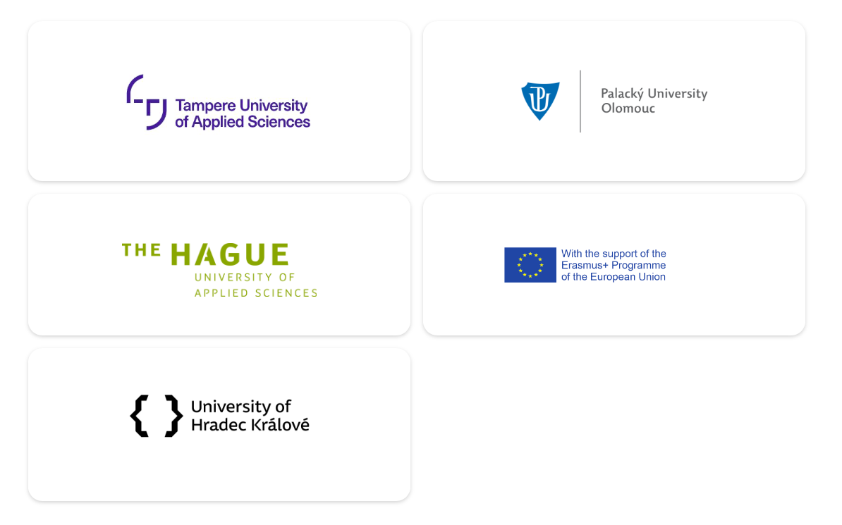
New for UP Academics:
1. Online Community – Going Virtual
Founded in 2021 as part of the Mitigating COVID Together ERASMUS KA2+ project
Institute for Excellence in Internationalization, Palacký University Olomouc, Czech Republic
The Hague University of Applied Science, Netherlands
Tampere University of Applied Science, Finland
University Hradec Králové, Czech Republic
Contact:
Maike Leidecker, Online Community Coordinator (maike.leidecker@upol.cz), Christopher Medalis, Mitigating COVID Together ERASMUS KA2+ project team lead (christopher.medalis@upol.cz)

Slide 5

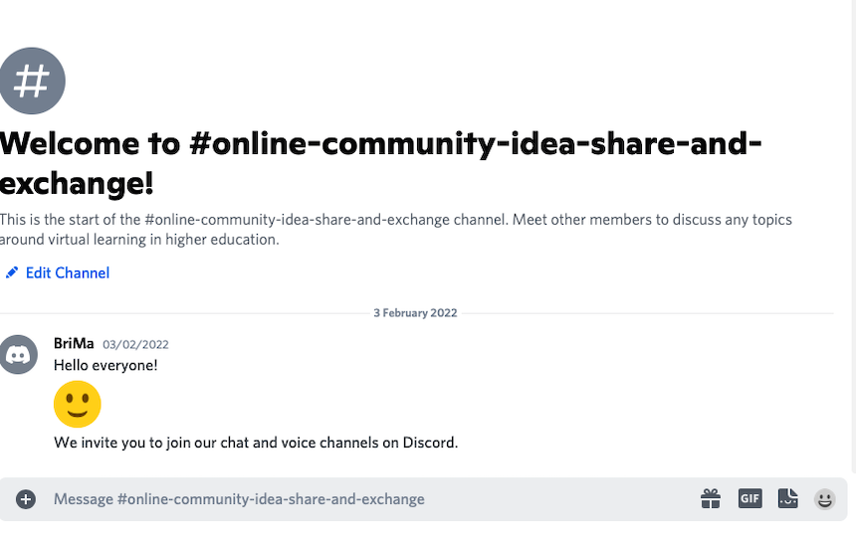
Online Community – Going Virtual
Website:
Repository of relevant resources for online teaching and learning in an international framework
Expert advice on virtual mobility experiences, contacts, event listings
Discord server:
Interactive Online Community (Closed channel)

Slide 6
NEW: Online Community
Online Community – Going Virtual

Slide 7
How to Join the Online Community

Slide 8
2. UPCOMING CONFERENCE under UP-led Erasmus Project "Mitigating COVID Together: Enhancing Capacities of Academics and Students in Virtual Learning and Teaching Spaces"
March 24, 2022 at University of Hradec Králové and online
Topics of the conference will include:
Comenius Ideas and Current Society, Character Formation as a Part of Holistic Education
Inclusive University Environment: Opportunities and Challenges
Online/Offline Teaching and Learning
International and Intercultural Aspects of Education and Professional Training
Collaborative Teaching and Learning: Opportunities – Challenges
Education and Professional Training during COVID-19: University Students ́ Perspectives and Experience
Registration: https://forms.office.com/r/54ReZaeunQ

Slide 9
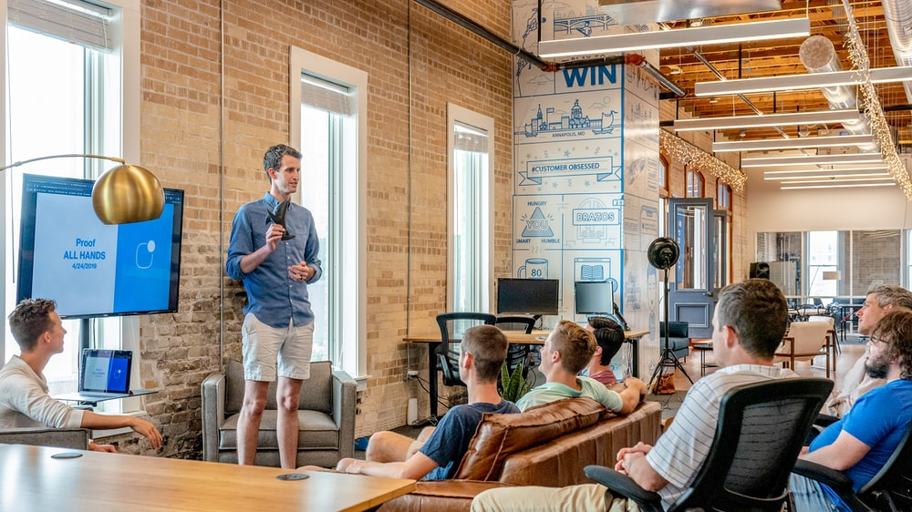


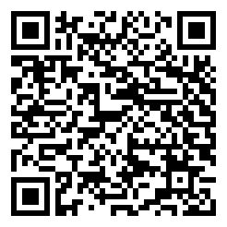
WORKSHOP with University of Minnesota
March 31, 16:30–18:00, Faculty of Law UP, room A.05
Making the International Classroom Inclusive
Facilitators: Dr. Christopher Johnstone & Dr. Eva Janebová
How academics can:
Use Universal Learning Design in the HE classroom.
Engage international students.
Make use of internal diversity in the classroom.
The capacity of the workshop is 25 people.
Register here, please.

Slide 10


SAVE THE DATE!
INFORMAL GATHERING to celebrate new Partnership
WHEN: April 1st
3:00–4:00 PM CEST (Olomouc) /8:00–9:00 AM CDT (Minnesota)
VENUE: Rector‘s Meeting Room UP, Online
Celebrating the newly started collaborations across faculties of UP and UMN
Vít Procházka, Eva Janebová
Mix and mingle (hybrid)
Joint UMN-UP Professional Community
Christopher Johnstone, Gayle Woodruff
Followed by coffee and cookies with Christopher Johnstone (University of Minnesota) and Dave Stepan (SOKOL Minnesota) at 4:00–4:30 PM.
..
Register here, please.

Slide 11

Palacký – Minnesota Professional Learning Community
PLC is NOT A TRAINING, it is coaching academics to:
Design and deliver international curricula
Become empowered International Educators

Slide 12
Contact the Institute for Excellence in Internationalization (IEI)
www.upol.cz/iei
Eva Janebová eva.janebova@upol.cz
Christopher Medalis christopher.medalis@upol.cz

